Slide 1


AUTOMATE EMAILS LIKE A PRO WITH MAILOZAURR!
Neha Patil
https://www.linkedin.com/in/nehapatil0707/

Slide 2

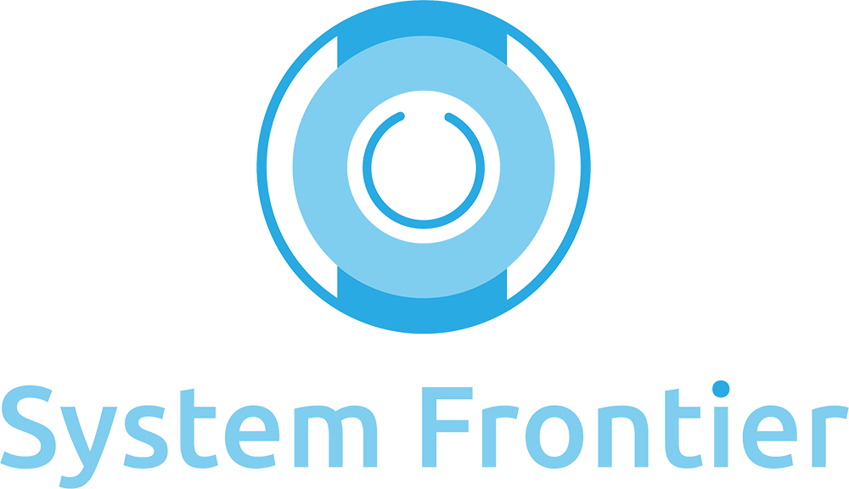



Thank you to our sponsors!

Slide 3

About me
Automation engineer at Align
Master’s in computer science degree from NC State
mentored by mike for over a year

Slide 4

Why automate emails?​
Because every team communicates through emails.
Because I take emails seriously...
Because I prefer to work smarter, not harder!

Slide 5
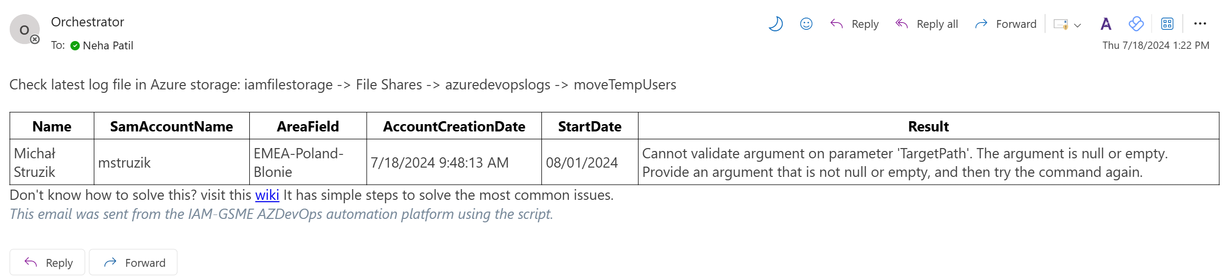
Scenarios
Notes:
Internal Alerts (onboarding example)
Renewal Emails (password expiry, keyvault expiry)
Welcome emails
Sending newsletters
Audit

Slide 6
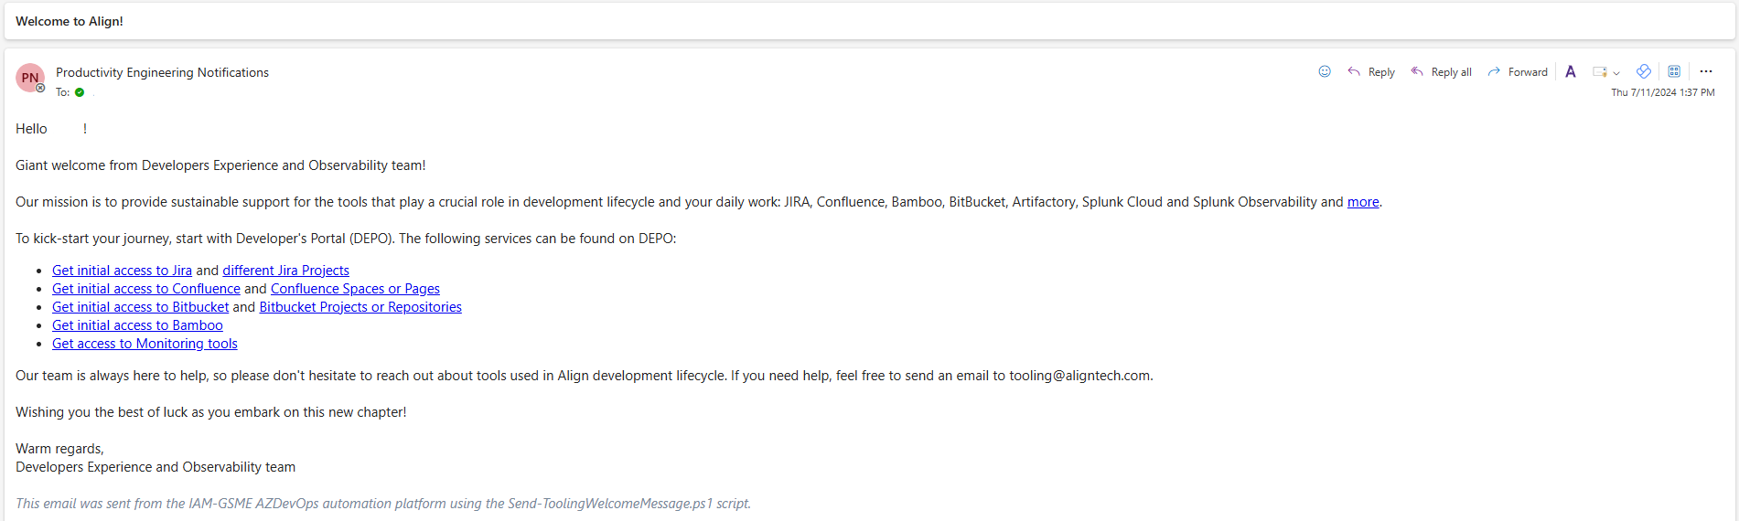
scenarios
Notes:
Internal Alerts (onboarding example)
Renewal Emails (password expiry, keyvault expiry)
Welcome emails
Sending newsletters
Audit

Slide 7
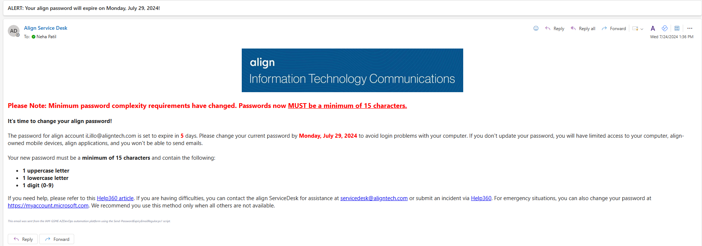
scenarios
Notes:
Internal Alerts (onboarding example)
Renewal Emails (password expiry, keyvault expiry)
Welcome emails
Sending newsletters
Audit

Slide 8
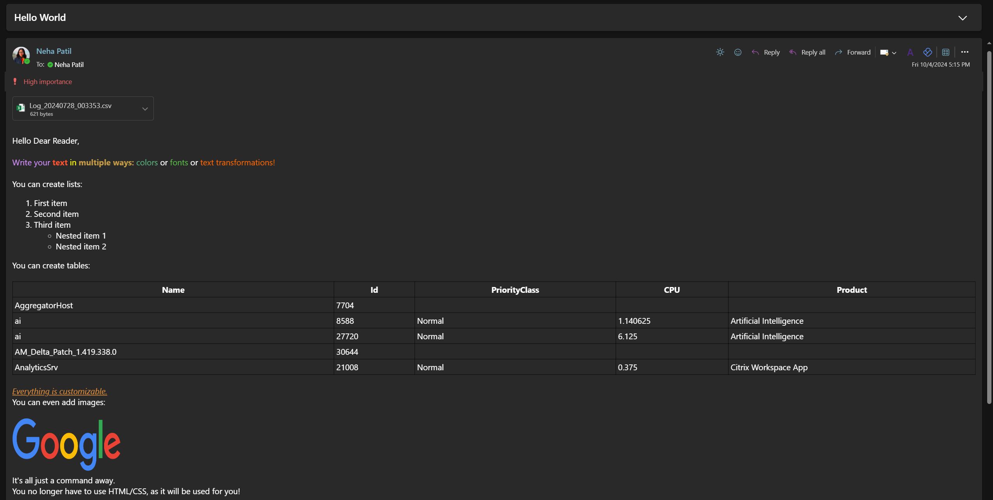
OLD WAY
Goal:
Notes:
Old way -> new way(hard one)-> new way (easy)(end of talk im gonna show howto do stuff in 30 lines)
Timer – remove screensaver
Dan hill –rtpsug – examples
This is how easy it used to be to send emails a few years ago. Its not allowed anymore because its not secure. They came up with Graph module instead which made this task significantly more difficult. I am going to show you how. Then ill introduce you a module that makes it as easy as the old way by the end of this talk.

Slide 9
Let’s get started
Notes:
How many ppl have tried sending via graph api?
How many sent formatted?(have to do html css right?)
Who knows html
Who likes css

Slide 10
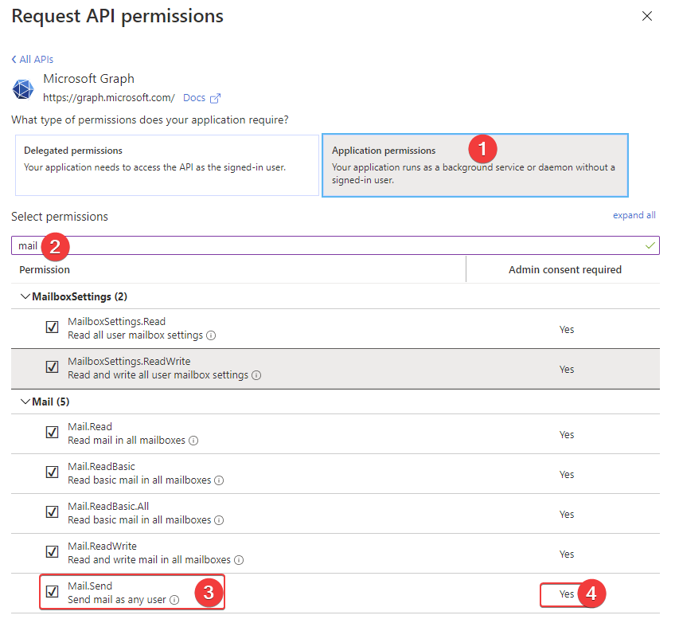
Permissions required
Notes:
Both modules connect to Microsoft graph so you need to create an Application in Azure that allows you to Send Emails.
an app registration (svc account in cloud) with graph api permissions.
Mail.Send: Allows sending emails as any user in the organization.
Once created, granted permissions, and generated secrets, you should have ApplicationID, ClientID, and ClientSecret. Alternatively, ClientSecret can be replaced with Certificate, making the process more secure.

Slide 11
Sending emails using Microsoft graph
“Send-MgUserMail” uses Graph API
Need to know HTML/CSS for formatted emails
Documentation link: Send-MgUserMail (Microsoft.Graph.Users.Actions) | Microsoft Learn
Code link: https://github.com/neha7799/Mailozaurr/tree/main/Hard%20Way
Notes:
What is Send-MgUserMail? Send-MgUserMail is a command in the Microsoft Graph PowerShell module that allows users to send email messages on behalf of a specified user within an organization.
visual capabilities of your emails are limited by HTML/CSS standards, not the Graph module itself.

Slide 12
Introducing mailozaurr
Why to use?
Because I’m lazier and I just want to send a simple email.
No need to know HTML/CSS (it uses PSWriteHTML module)
Abstracts the complexities / Intuitive syntax
Better readability and maintainability of code
Installation: Install-Module -Name Mailozaurr –Scope AllUsers
Documentation: Easy way to send emails using Microsoft Graph API (Office 365) with PowerShell - Evotec
Code link: Mailozaurr/Easy Way at main · neha7799/Mailozaurr (github.com)
Notes:
What is Mailozaurr? Mailozaurr is a PowerShell module designed to simplify and enhance the process of sending emails using the Microsoft Graph API. It offers a user-friendly interface and advanced features for managing email communication within Microsoft 365 environments.
Key Features
Simplified Email Sending:
Mailozaurr abstracts the complexities of the Microsoft Graph API, allowing users to send emails with straightforward commands.
Offers an intuitive syntax, making it easier for users without extensive coding experience to send emails.

Slide 13
Comparing both modules
LOC of | Graph Module | Mailozaurr
Hello World​ | 40 | 19
+ Styling Text​ | 72 | 31
+ Table​ | 108 | 45
Notes:
Go to documentation:

Slide 14
THANK YOU ☺

